Slide 1




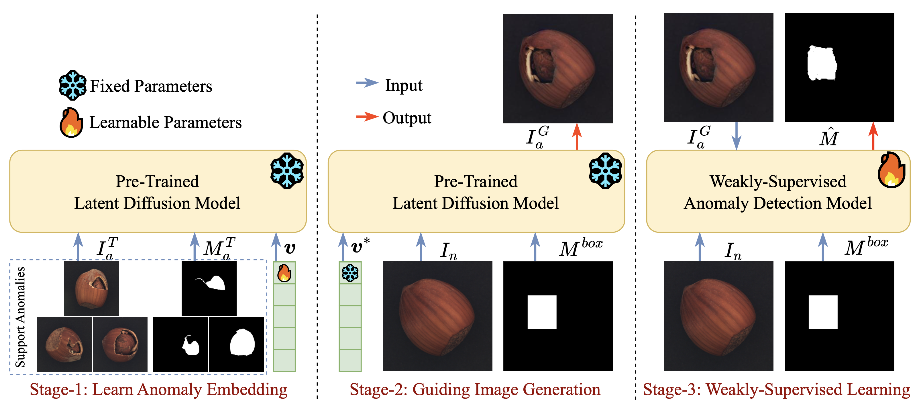
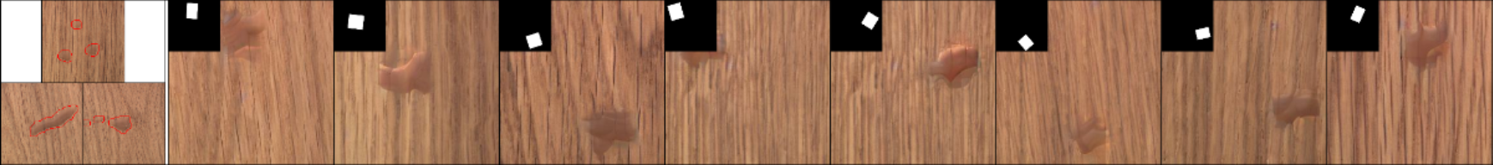
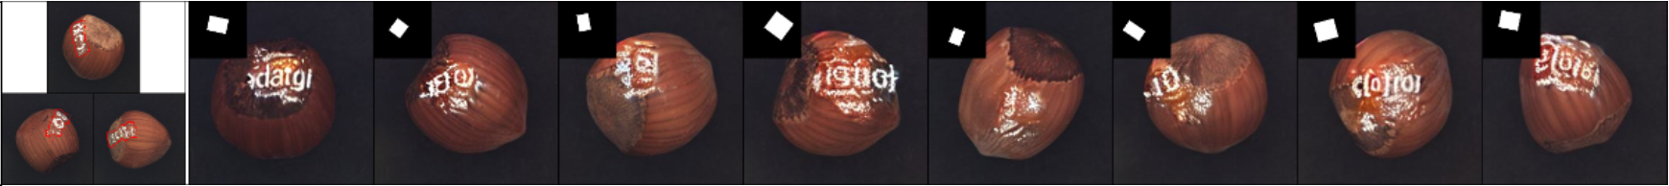
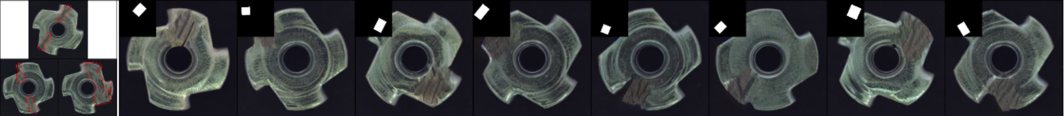
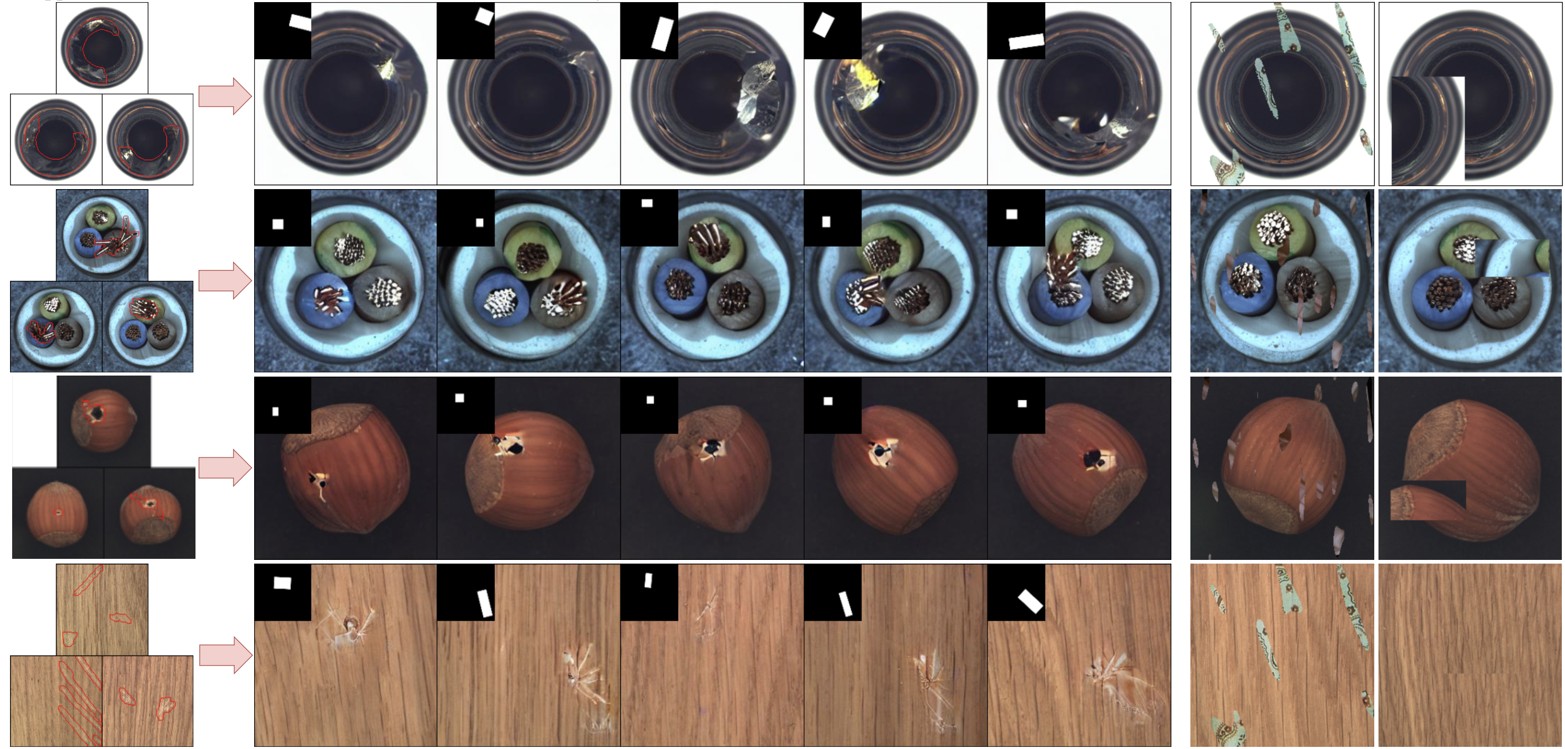
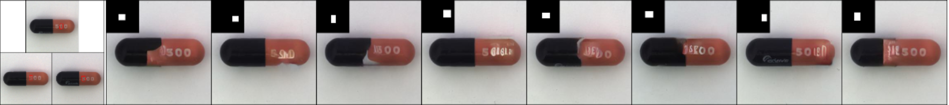
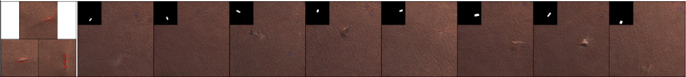
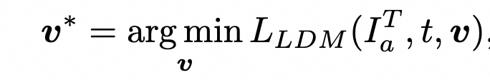
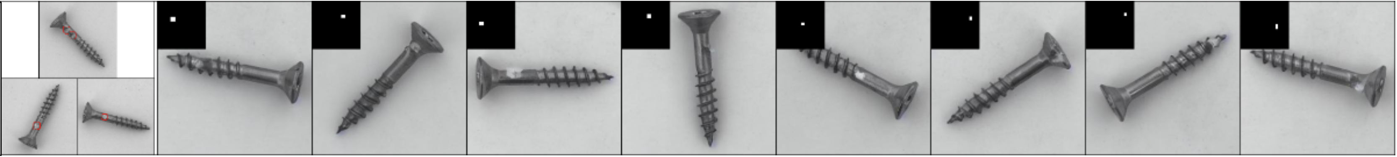
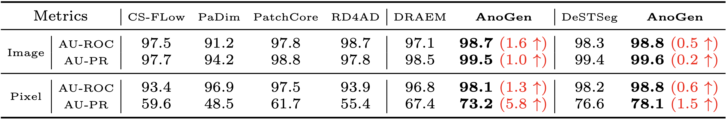
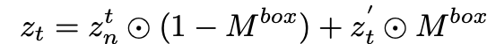
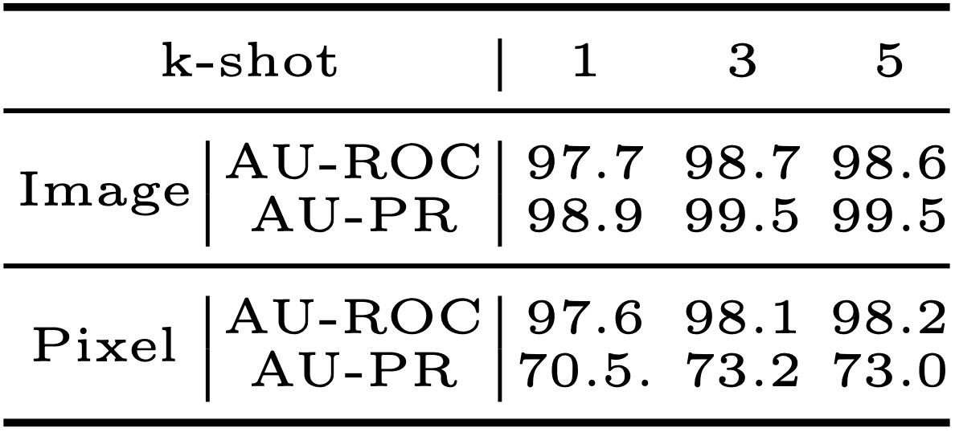
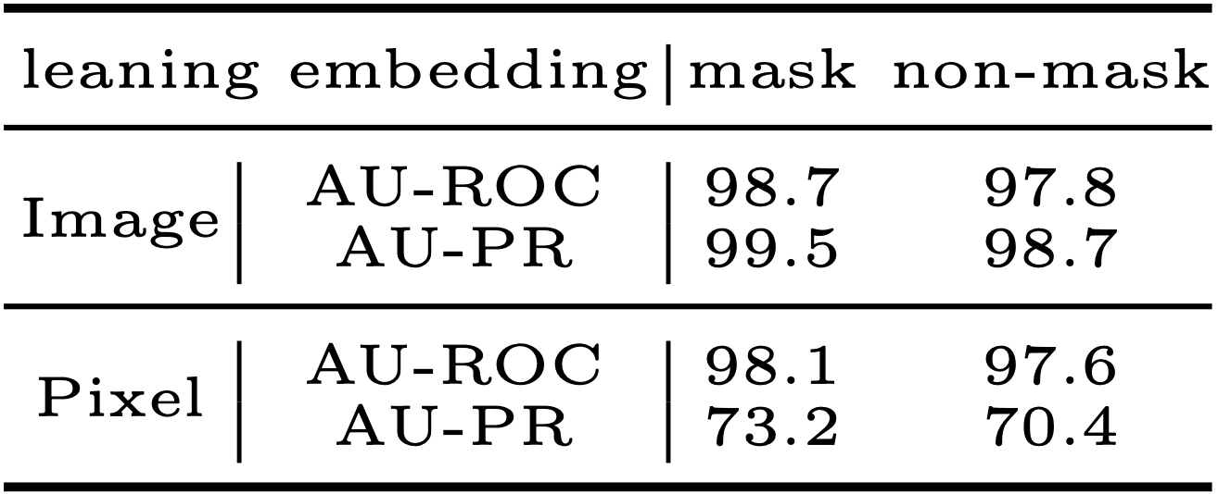
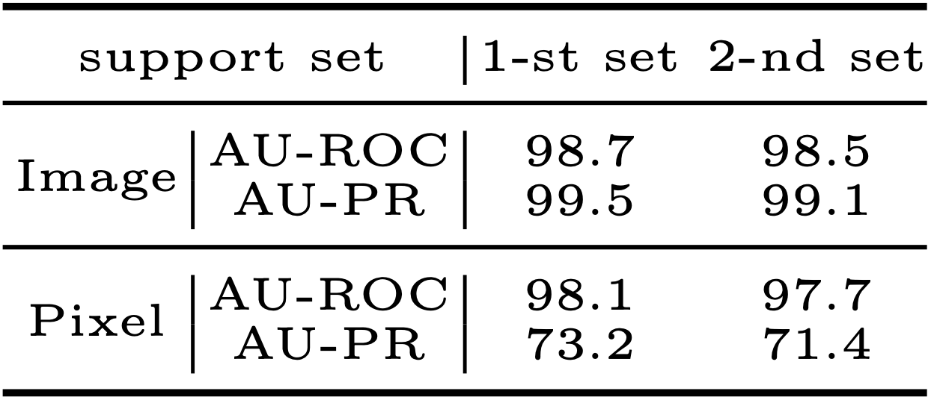
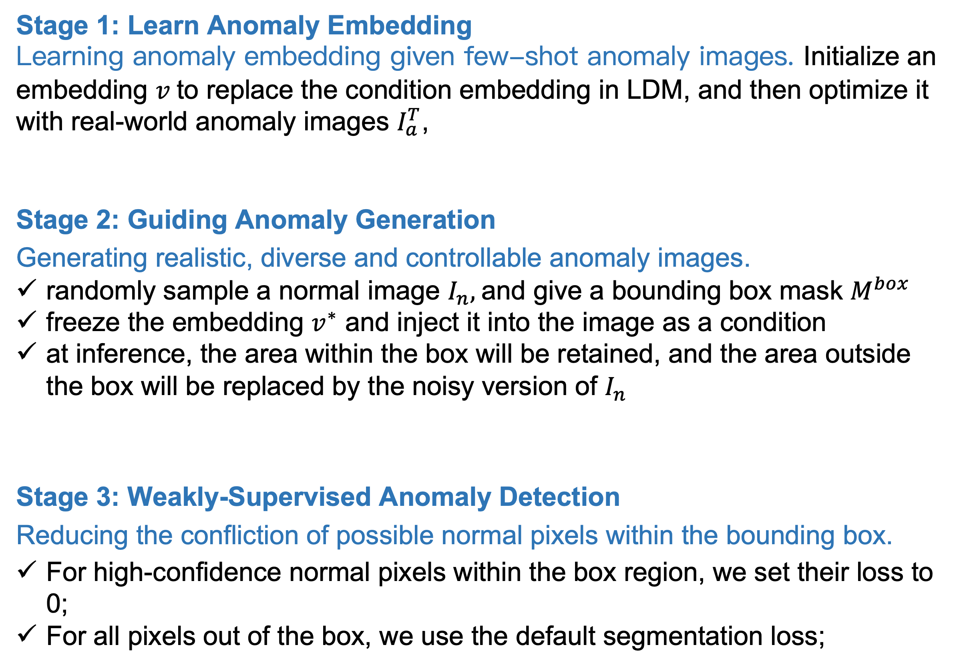
Few-Shot Anomaly-Driven Generation for Anomaly Classification and Segmentation
Guan Gui¹, Bin-Bin Gao¹, Jun Liu, Chengjie Wang and Yunsheng Wu
MILANO 2024
1. Introduction
2. Our Method: AnoGen
3. Experiments
Anomaly Detection Challenges
Challenge 1:The anomaly data in the real-world is extremely scarcity, making the AD tasks highly challenging.
Most unsupervised learning methods perform poorly in anomaly segmentation due to the lack of discriminative guidance from anomaly data.
Recent works, e.g., DRAEM, CutPaste, and SimpleNet, attempt to synthesize anomalies, bringing superior anomaly segmentation performance. However, the improvements are limited because there is a semantic gap between real and synthesized anomalies.
Challenge 2: Generative modes, e.g., GANs and LDMs, achieve remarkable progress in creating realistic and diverse images, but they require a large number of training images.
Challenge 3: It is difficult to obtain accurate defect masks for generated images using generative modes.
Inspiration: How to generate realistic and diverse anomaly images with generative models given only few-shot real anomaly images?
AnoGen Framework
3.1 Generated Anomaly Images
By using three real anomaly images as a driving, we have successfully generated diverse, realistic and spatially controllable anomaly images.
real-world anomalies
generated anomalies
using our AnoGen
synthetic anomalies
DREAM, CutPaste
Stage 1: Learn Anomaly Embedding
Learning anomaly embedding given few-shot anomaly images. Initialize an embedding $v$to replace the condition embedding in LDM, and then optimize it with real-world anomaly images $I_{a}^{T}$,
Stage 2: Guiding Anomaly Generation
Generating realistic, diverse and controllable anomaly images.
randomly sample a normal image $I_{n},$and give a bounding box mask $M^{box}$
freeze the embedding $v^{∗}$ and inject it into the image as a condition
at inference, the area within the box will be retained, and the area outside the box will be replaced by the noisy version of $I_{n}$
Stage 3: Weakly-Supervised Anomaly Detection
Reducing the confliction of possible normal pixels within the bounding box.
For high-confidence normal pixels within the box region, we set their loss to 0;
For all pixels out of the box, we use the default segmentation loss;
3.2 Comparisons on Anomaly Classification and Segmentation
Generated anomalies effectively improve the model performance of both anomaly classification and segmentation tasks simultaneously.

